Slide 1

Healthify

Slide 2
Table of Contents
EcoSystem Introduction
Problem Statement
Solution
Enterprise and Organizations
Roles and Work Request
Java Features
Object model
UML Diagram
User Interface
Scalability
Conclusion

Slide 3
Problem
Market Gap
Customers
Financials
The need for medical equipment continues to be consumer driven, but we're seeing a lapse of availability in the market for wholesale medical supplies​
15% increase of retail sales of medical equipment proves that there's consumer interest for more wholesale availability​
Medical equipment sales were up by $25 million in 2020
Costs
Usability
Loss of sales by not offering wholesale medical supplies
Customers want products that are safe and easy to stock in their hospitals​

Slide 4




Solution
Close the gap
Target Audience
Our product makes ordering medical equipment easier​
Order your medicines online and have them delivered to your home
Cost savings
Easy to use
Paying medical bills online easily.
You can request an ambulance and check the results of your lab tests online.

Slide 5

Product Overview
HOSPITAL
Pharmacy
DOCTOR ORG
RECEPTIONIST
AMBULANCE
LAB ASSISTANT
ACCOUNTANT
PATIENT
DELIVERYMAN
PHARMACY
CDC
pharmaceutical
​GOVERNMENT
PHARMACEUTICAL ORG.

Slide 6

ROLES AND WORK REQUESTS
ROLES
WORK REQUESTS
DOCTOR
RECEPTIONIST
AMBULANCE DRIVER
LAB ASSISTANT
ACCOUNTANT
PATIENT
DELIVERYMAN
PHARMACY ADMIN
CDC ADMIN
SYSTEM ADMIN
HOSPITALADMIN
PHARMACY ADMIN WORK REQUEST
RECEPTION WORK REQUEST
PHARMACEUTICAL ADMIN WORK REQUEST
ACCOUNT WORK REQUEST
AMBULANCE DRIVR WORK REQUEST
CDC WORK REQUEST
DELIVERYMAN WORK REQUEST
DOCTOR WORK REQUEST
HOSPITAL ADMIN WORK REQUEST
LAB ASSISTANT WORK REQUEST
PATIENT WORK REQUEST

Slide 7
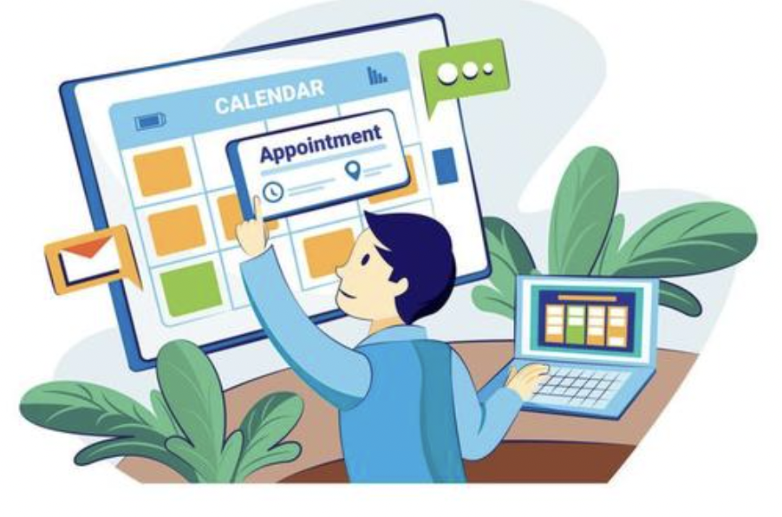

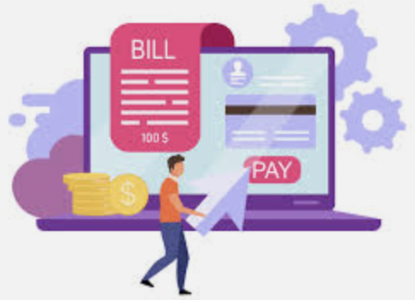

Advanced java features
Receive receipt by email
Receive a zoom meeting invite with doctor via email
Government officials can download the patient records as a pdf
Receive the lab test results by email

Slide 8
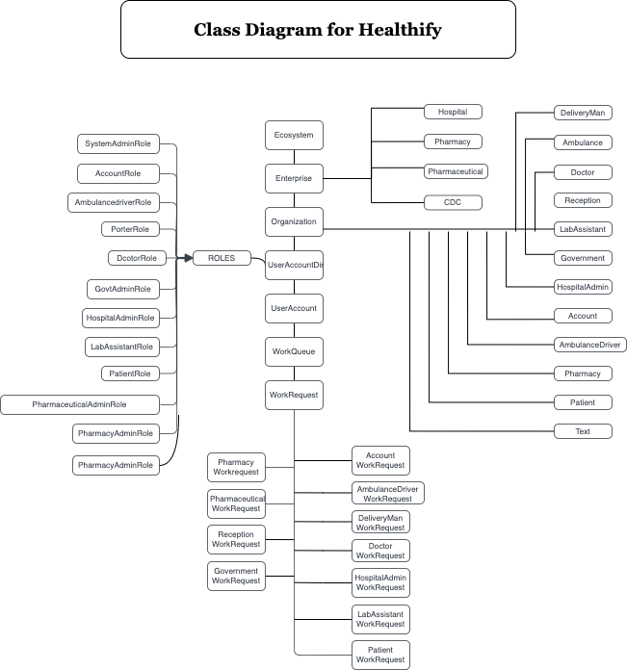
Object model

Slide 9

User interface

Slide 10
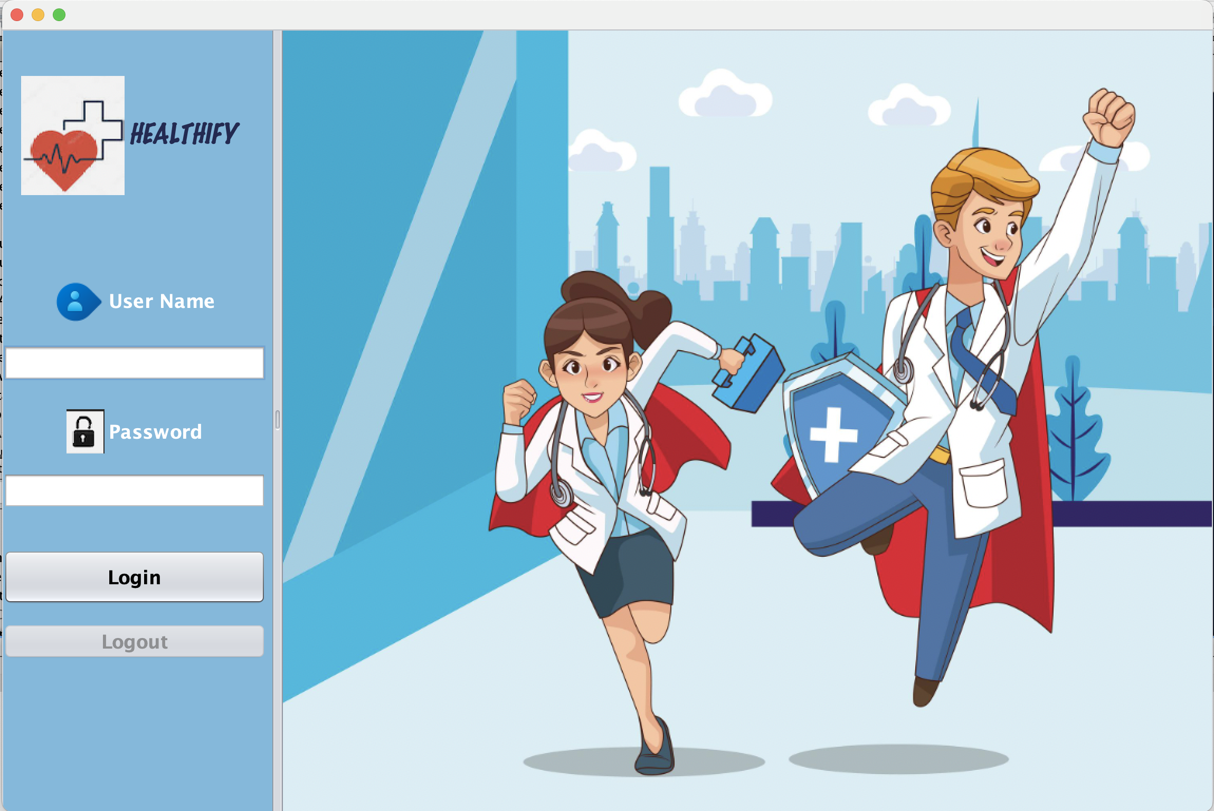

Slide 11
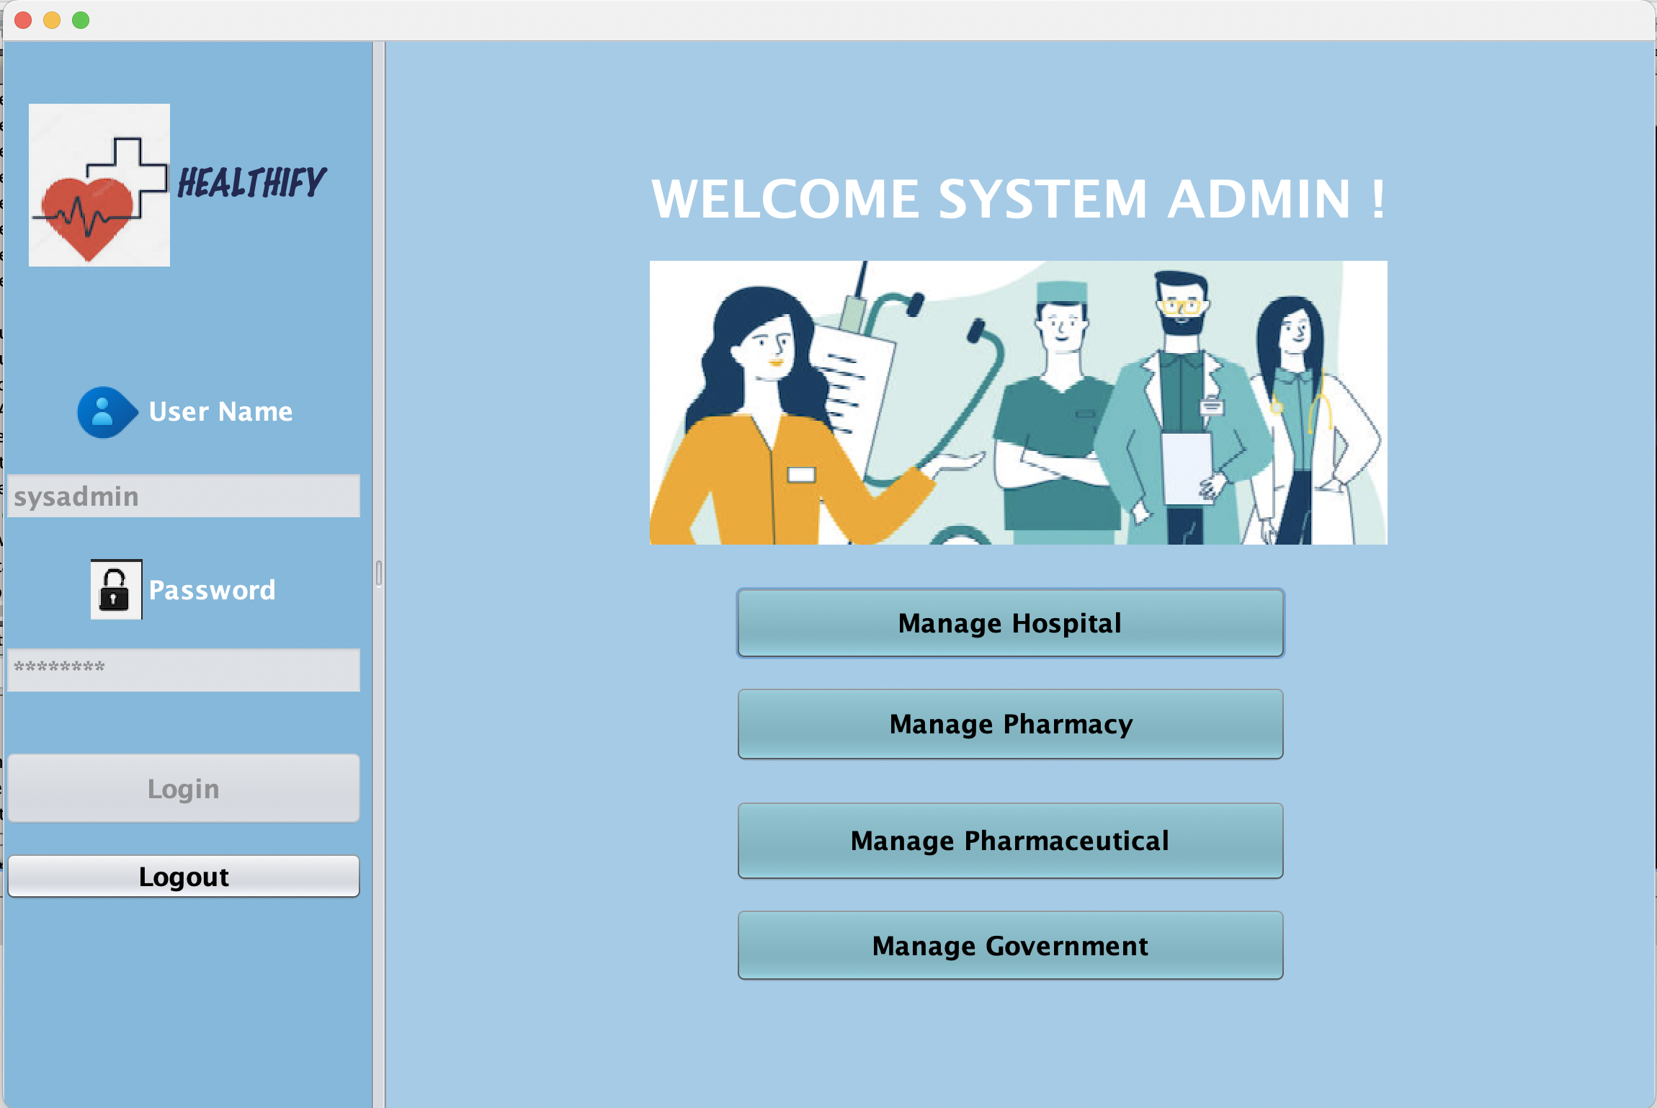

Slide 12
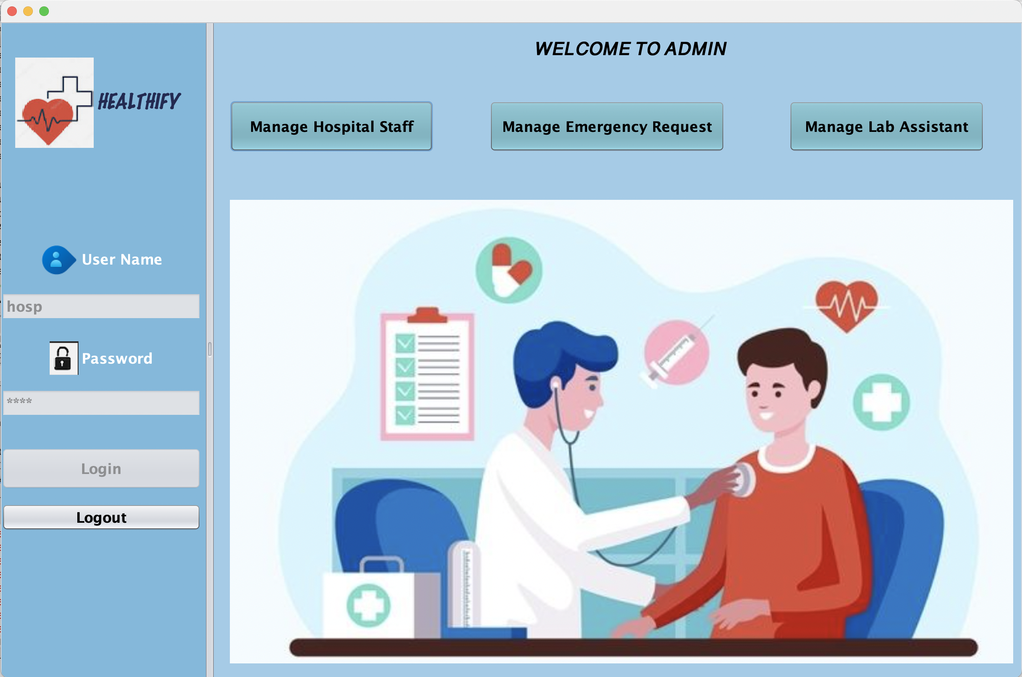

Slide 13
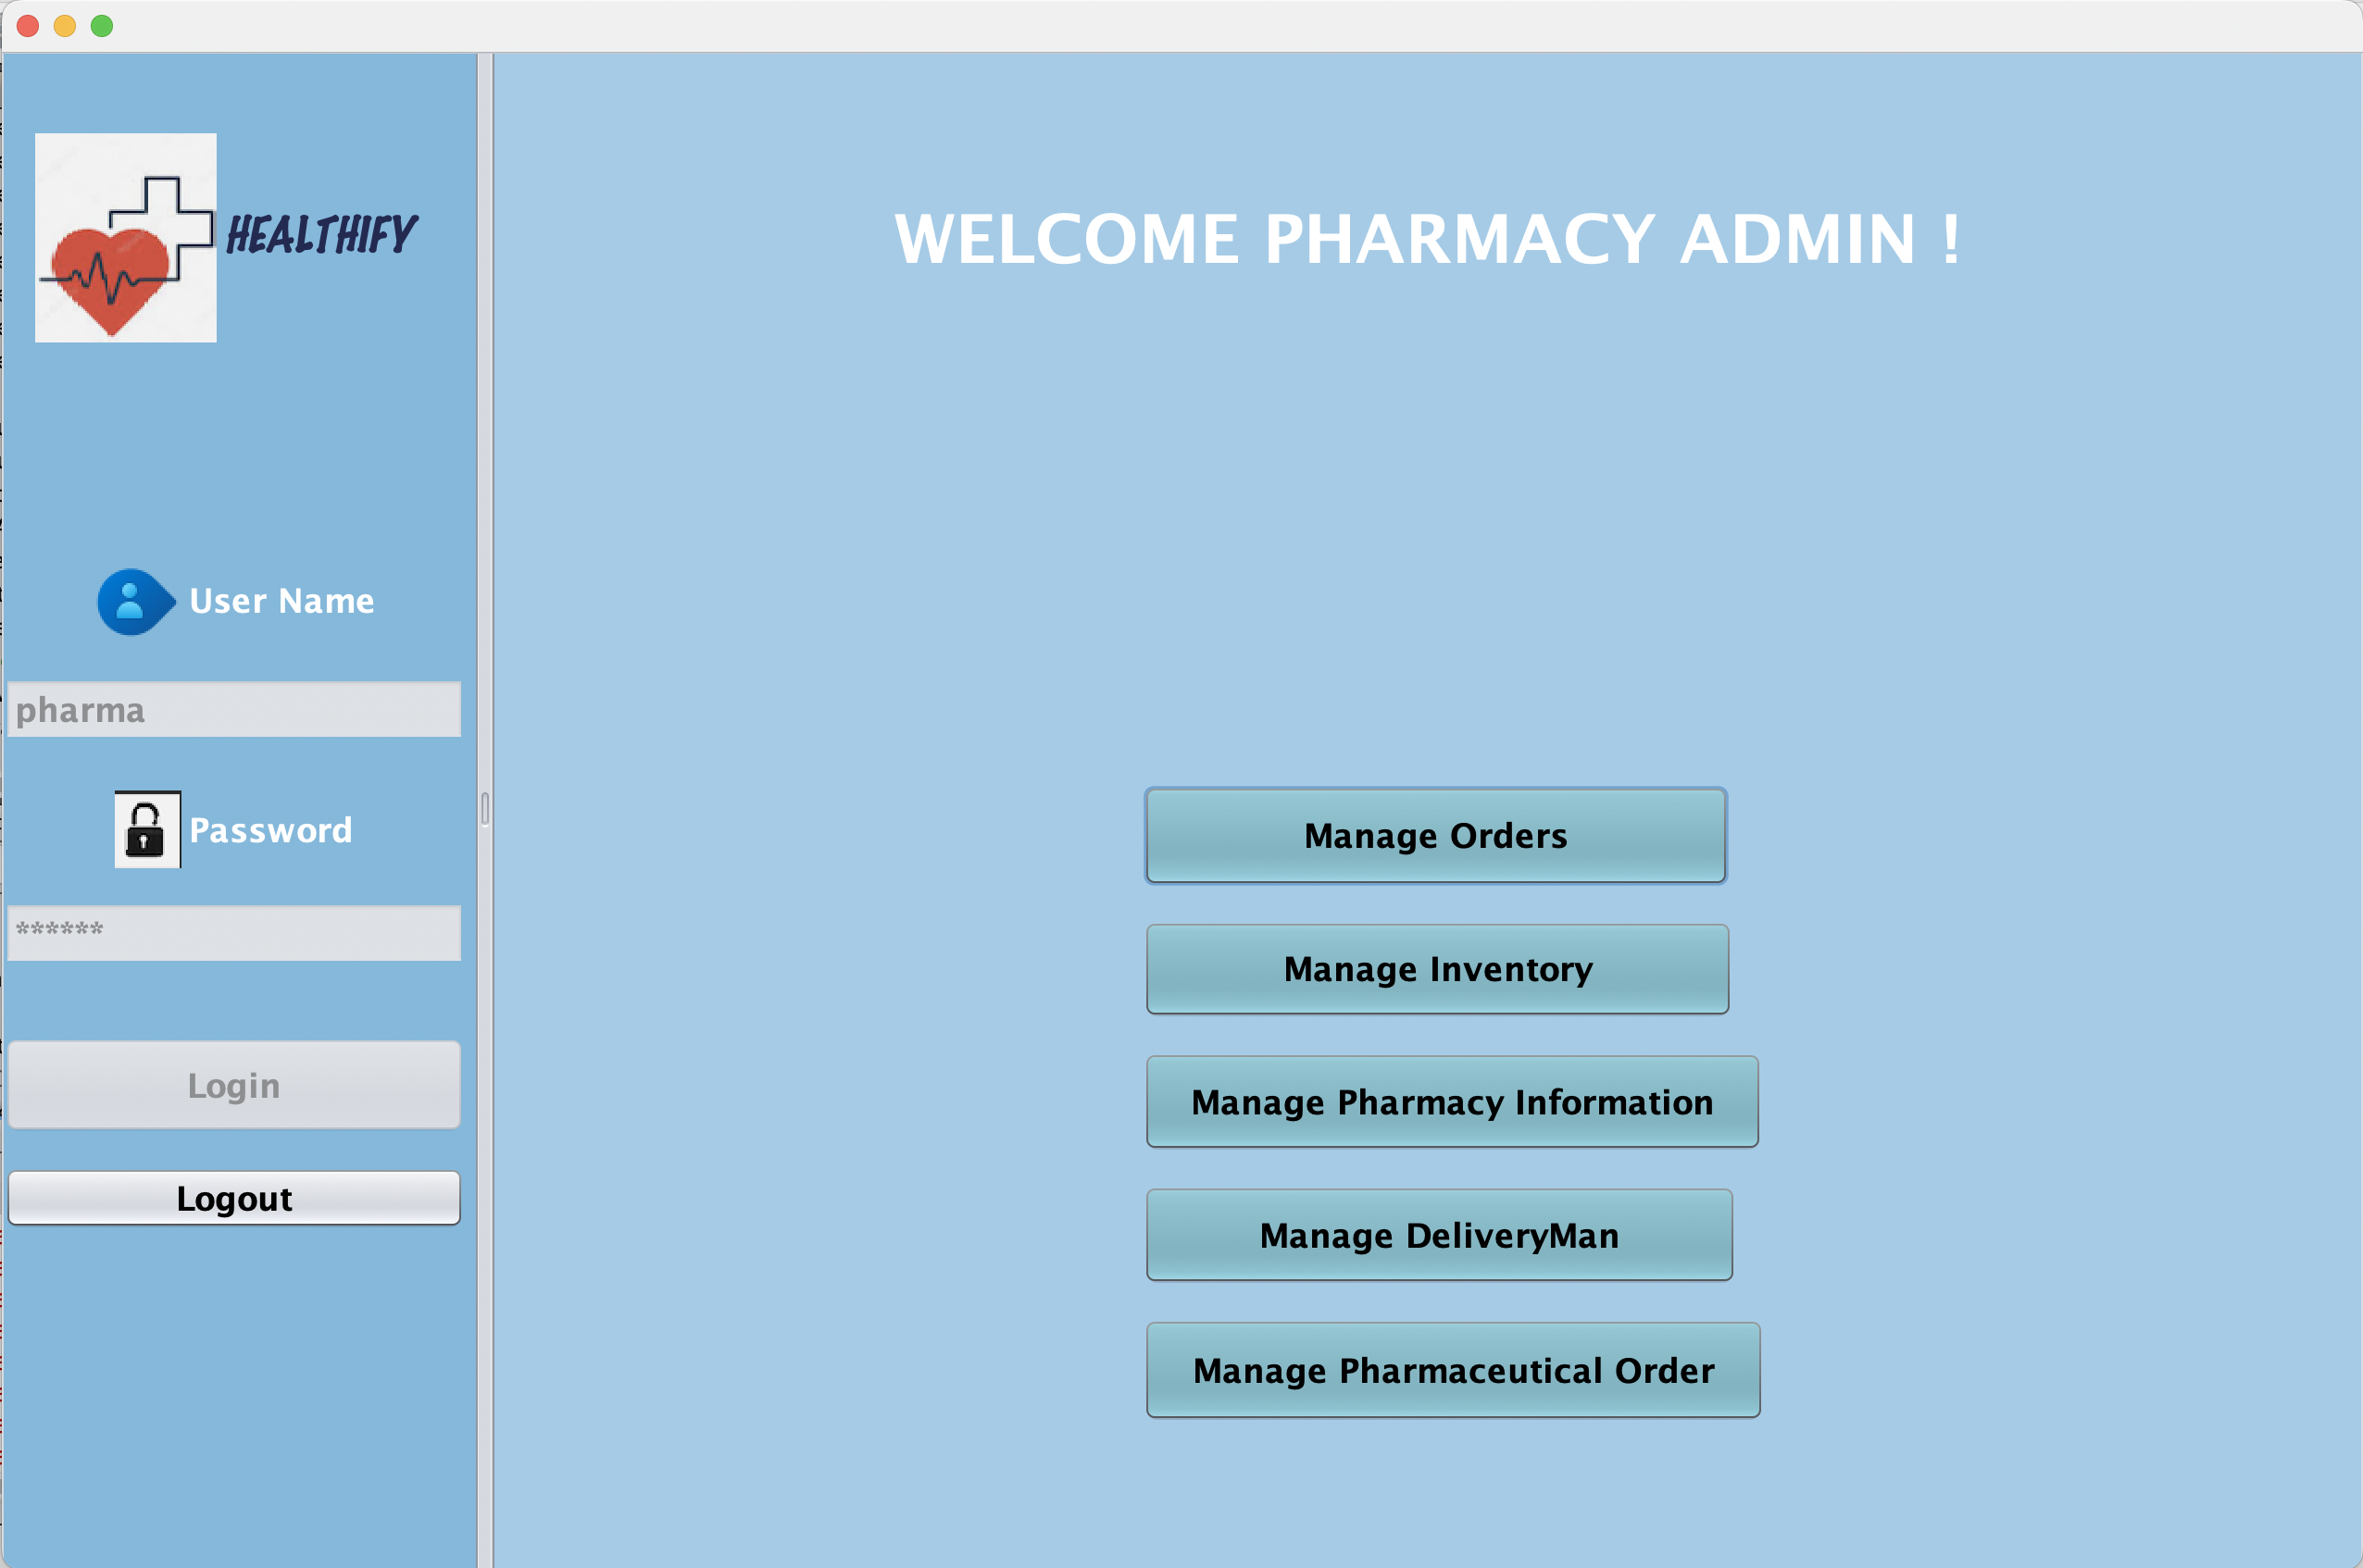

Slide 14
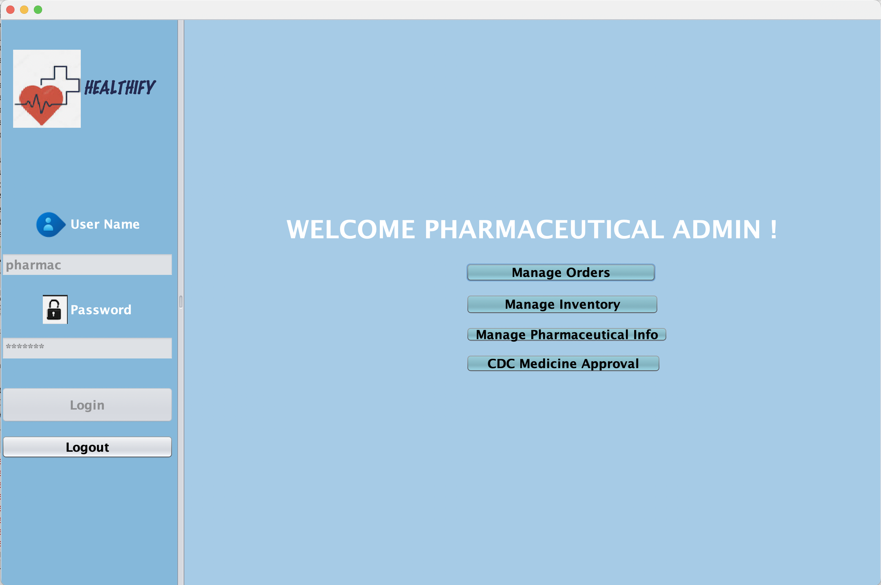

Slide 15
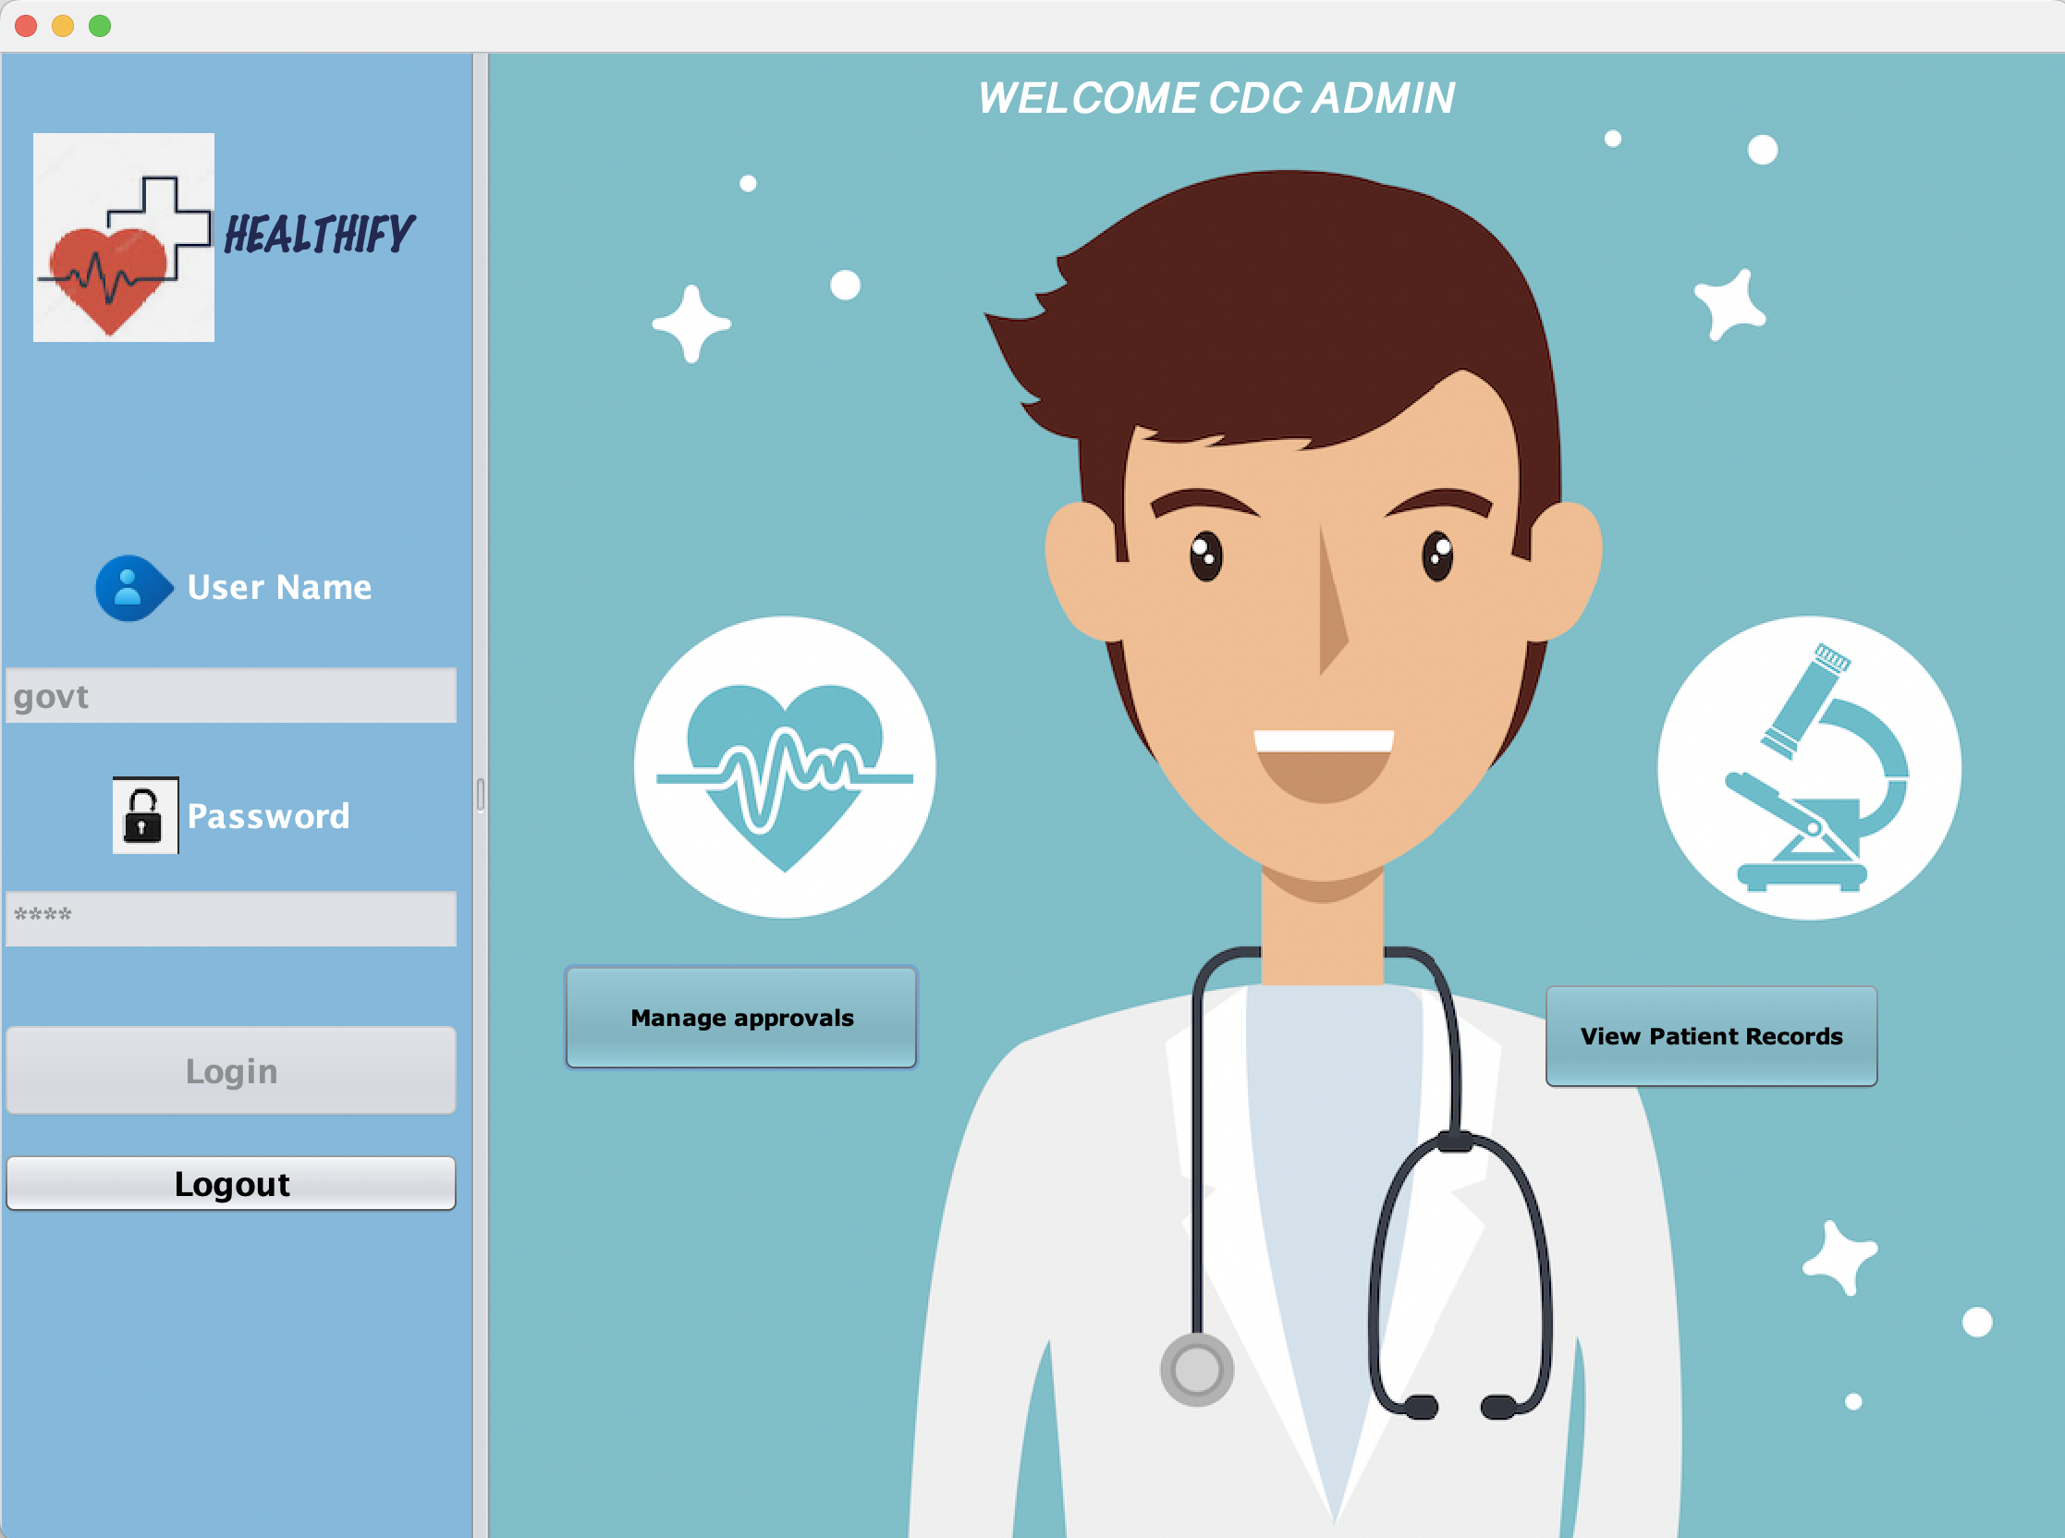

Slide 16

Summary
Our model addresses the issues faced during an ongoing pandemic. From reducing appointment wait time to automated reports sent to the patient's email, our model targets and provides a solution to all this and more. We make it easy for the patient to track the status of their appointment to providing a repository of their records. All this results in less paper work and over the counter transactions. Our design is scalable across all regions and future demands.

Slide 17

Thank you
Mirjam Nilsson​​
206-555-0146​
mirjam@contoso.com​
www.contoso.com​

